Slide 1
XML SAX Processing
Comp4711
#6 – Feb 10/09

Slide 2
XML SAX Processing
SAX???
SAX Events
SAX Processing
The SAX API
SAX pros/cons
Examples

Slide 3
1. What is SAX?
Simple, event based API for XML parsers
Process based on "events" encountered as document is read
Event based API vs. tree based API (DOM)‏
SAX javadocs found at: http://www.saxproject.org

Slide 4
What Does That Mean?
Does not require creation of internal tree structure. Therefore ,one can parse large XML document without running out of system memory
Using a SAX parser means being a content handler
  listen to callbacks from the parser
Low level, compared to DOM

Slide 5
2. Events
SAX provides events for the following structural information for XML documents:
  The start and end of the document
  Document type declaration
  The start and end of elements
  Attributes of each element
  Character data
  Unparsed entity declarations
  Notation declarations
  Processing instructions
As a programmer, you have to keep in mind the sequence of events that are fired

Slide 6
XML Sample File
<?xml version="1.0"?>
<samples>
<server>UNIX</server>
<monitor>color</monitor>
</samples>

Slide 7
Example SAX Events
Start document
Start element (samples)
Characters (white space)
Start element (server)
Characters (UNIX)
End element (server)
Characters (white space)
Start element (monitor)
Characters (color)
End element (monitor)
Characters (white space)
End element (samples)

Slide 8
3. Steps to SAX Processing
Create an event handler.
Create the SAX parser.
Assign the event handler to the parser.
Parse the document, sending each event to the handler.

Slide 9
Creating an Event Handler
Before an application can use SAX to process an XML document, it must create an event handler.
SAX provides a class, DefaultHandler, that applications can extend.
Proper parsing using SAX requires specific calls to the handler's methods,
Cannot be static

Slide 10

import org.xml.sax.helpers.DefaultHandler;
public class SurveyReader extends DefaultHandler
{
public SurveyReader() {
System.out.println("Object Created.");
}
public void showEvent(String name) {
System.out.println("Hello, "+name+"!");
}
public static void main (String args[]) {
SurveyReader reader = new SurveyReader();
reader.showEvent("Nick");
}
}

Slide 11
Creating a Parser
With the event handler in place, the next step is to create the parser, or XMLReader, using the SAX driver.
This example uses a pair of classes, SAXParserFactory and SAXParser, to create the parser
First declare the XMLReader, xmlReader, and then use SAXParserFactory to create a SAXParser.

Slide 12
import org.xml.sax.helpers.DefaultHandler;
import javax.xml.parsers.SAXParser;
import javax.xml.parsers.SAXParserFactory;
import org.xml.sax.XMLReader;
public class SurveyReader extends DefaultHandler
{
public SurveyReader() {
}
public static void main (String args[]) {
XMLReader xmlReader = null;
try {
SAXParserFactory spfactory =
SAXParserFactory.newInstance();
SAXParser saxParser = spfactory.newSAXParser();
xmlReader = saxParser.getXMLReader();
} catch (Exception e) {
System.err.println(e);
System.exit(1);
}
}
}

Slide 13
Setting a Content Handler
Events detected by reader or parser trigger function calls in the content handler
Commonly known as callbacks in the event driven model
DefaultHandler class provides default event handlers that can be over ridden
In our example we use SurveyReader

Slide 14
public class SurveyReader extends DefaultHandler
{
public SurveyReader() {
}
public static void main (String args[]) {
XMLReader xmlReader = null;
try {
SAXParserFactory spfactory =
SAXParserFactory.newInstance();
SAXParser saxParser =
spfactory.newSAXParser();
xmlReader = saxParser.getXMLReader();
xmlReader.setContentHandler(new
SurveyReader());
} catch (Exception e) {
System.err.println(e);
System.exit(1);
}
}
}

Slide 15
Parsing the Input Source
Sax provides a wrapper class called InputSource for the actual source file
The parse method of the xmlreader processes the InputSource and sends the events to the content handler as they are encountered

Slide 16
import org.xml.sax.InputSource;
public class SurveyReader extends DefaultHandler
{
public SurveyReader() {
}
public static void main (String args[]) {
XMLReader xmlReader = null;
try {
SAXParserFactory spfactory =
SAXParserFactory.newInstance();
SAXParser saxParser =
spfactory.newSAXParser();
xmlReader = saxParser.getXMLReader();
xmlReader.setContentHandler(new
SurveyReader());
InputSource source = new inputSource("surveys.xml");
xmlReader.parse(source);
} catch (Exception e) {
System.err.println(e);
System.exit(1);
}
}
}

Slide 17
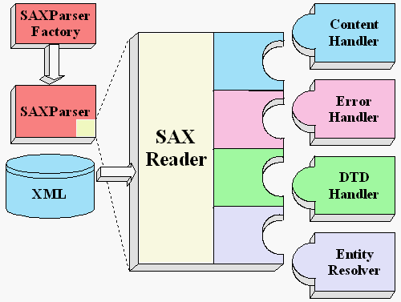
How it all fits together
Creates an instance of the parser determined by the system property.
Interface that defines methods startDocument, endDocument, startElement, endElement, characters and processingInstruction
Interface that defines methods error, fatalError, and warning
Abstract class that defines several kinds of parse() methods.
You will generally never be called upon to use this interface
The SAXParser wraps a SAXReader. It is the SAXReader which carries on the conversation with the SAX event handlers you define.
The resolveEntity method is invoked when the parser must identify data identified by a URI.

Slide 18
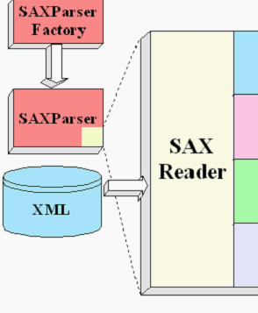
4. SAX API interfaces
Interfaces implemented by XML parser:
SAX Interface
Description
XMLReader
Interface for reading an XML document using callbacks
Attributes
Interface for a list of XML attributes.
Locator
Associates a SAX event with a document location
Interfaces implemented by the application:
SAX Interface
Description
ContentHandler
Provides callback methods to receive notification of general document events
DTDHandler
Provides callback methods to receive notification of DTD events
EntityResolver
If a SAX application needs to implement handling of external entities, then it must implement this interface
ErrorHandler
If a SAX application needs to implement customized error handling, then it must implement this interface

Slide 19
SAX API classes
Easy way to program in SAX
Standard SAX classes:
SAX class
Description
SAXParser
Abstract class that defines the API that wraps an XMLReader implementation class
DefaultHandler
Implements default behavior for four SAX interfaces: ContentHandler, DTDHandler, EntityResolver & ErrorHandler
InputSource
Allows a SAX application to encapsulate information about an input source in a single object
SAXException
SAXParseException
Helper classes in org.xml.sax.helpers package:
SAX class
Description
SAXParserFactory
  Creates an instance of the parser determined by the system property,
AttributeListImpl
Default implementation of the Attributes interface.
LocatorImpl

Slide 20
5. SAX vs DOM
Purpose of the application
  Making changes then saving to XML is easier using DOM
Amount of data
  SAX handles large files better
How the data will be used
  DOM less more SAX
The need for speed
  DOM less more SAX

Slide 21
6. Examples
org.w3c.sax document reading
JDOM document reading
org.w3c.sax
JDOM sax example

Slide 22
org.w3c.sax Document Reading
// Parses an XML file using a SAX parser.
// If validating is true, the contents is validated against
// the DTD specified in the file.
public static void parseXmlFile(String filename, DefaultHandler handler, boolean validating) {
try {
// Create a builder factory
SAXParserFactory factory = SAXParserFactory.newInstance();
factory.setValidating(validating);
// Create the builder and parse the file
factory.newSAXParser().parse(new File(filename), handler);
} catch (SAXException e) {
// A parsing error occurred; the xml input is not valid
} catch (ParserConfigurationException e) {
} catch (IOException e) {
}
}

Slide 23
JDOM Document Reading
// Parses an XML file using a JDOM SAX parser.
// If validating is true, the contents is validated against
// the DTD specified in the file.
public static void parseXmlFile(String filename, SAXHandler handler, boolean validating) {
try {
// Create a builder factory
SAXBuilder builder = new SAXBuilder();
builder.configureContentHandler(handler);
builder.setValidation(validating);
Document doc = builder.build(filename);
} catch (JDOMException e) {
// A parsing error occurred
} catch (IOException e) {
}
}

Slide 24
org.w3c.sax example
// This class listens for startElement SAX events
static class MyHandler extends DefaultHandler {
// This method is called when an element is encountered
public void startElement(String namespaceURI, String localName, String qName, Attributes atts) {
// Get the number of attribute
int length = atts.getLength();
// Process each attribute
for (int i=0; i<length; i++) {
// Get names and values for each attribute
String name = atts.getQName(i);
String value = atts.getValue(i);
// The following methods are valid only if the parser is namespace-aware
// The uri of the attribute's namespace
String nsUri = atts.getURI(i);
// This is the name without the prefix
String lName = atts.getLocalName(i);
}
}
}

Slide 25
JDOM SAX Example
Filter
  Element, attribute, ...
Consolidator
  Characters
???

